Slide 1
Correlation
Chapter 15

Slide 2
Correlations: Measuring and Describing Relationships
A correlation is a statistical method used to measure and describe the relationship between two variables.
A relationship exists when changes in one variable tend to be accompanied by consistent and predictable changes in the other variable.

Slide 3
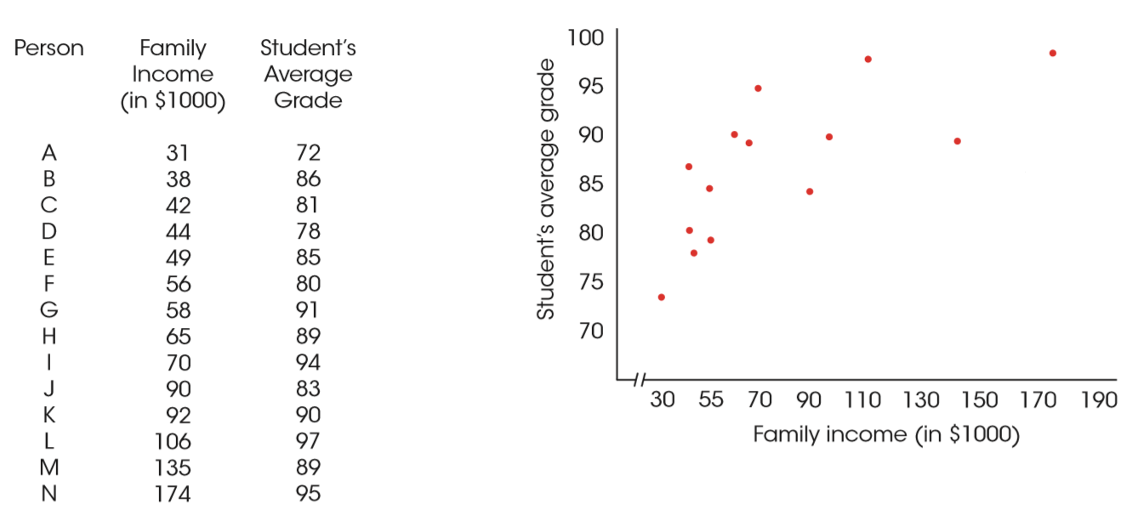
Correlational Data
Notes:
FIGURE 15.2 Correlational data showing the relationship between family income (X) and student grades (Y) for a sample of n = 14 high school students. The scores are listed in order from lowest to highest family income and are shown in a scatter plot.

Slide 4
Correlations: Measuring and Describing Relationships (cont'd.)
A correlation typically evaluates three aspects of the relationship:
The direction
In a positive relationship, the two variables tend to change in the same direction. This is indicated by a positive correlation coefficient.
In a negative relationship, the two variables tend to go in opposite directions. This inverse relationship is indicated by a negative correlation coefficient.

Slide 5
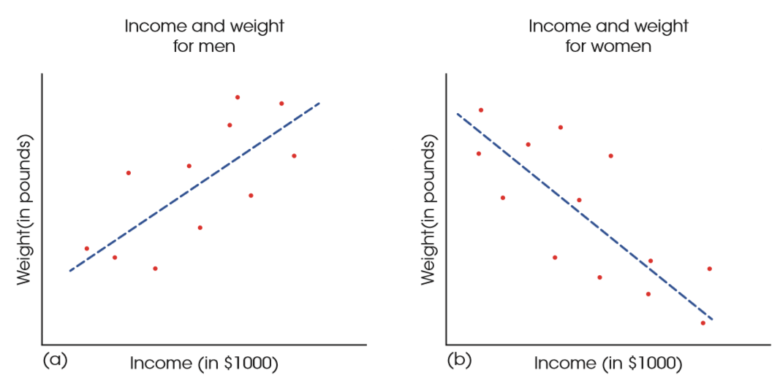
Negative and Positive Relationships
Notes:
FIGURE 15.1 Examples of positive and negative relationships. (a) Income is positively related to weight for men. (b) Income is negatively related to weight for women.

Slide 6
Correlations: Measuring and Describing Relationships (cont'd.)
The form
The most common use of correlation is to measure straight-line relationships.
However, other forms of relationships do exist and there are special correlations used to measure them.
The strength
The correlation measures the consistency of the relationship.

Slide 7
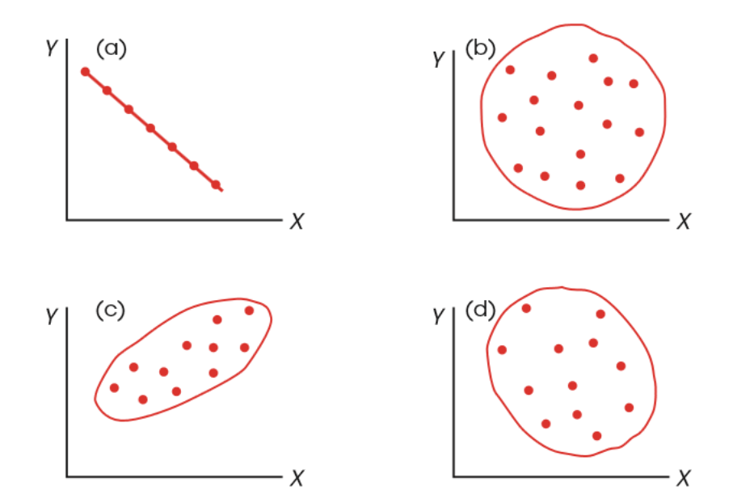
Different Values for Linear Correlations
Notes:
FIGURE 15.3 Examples of different values for linear correlations: (a) a perfect negative correlation, –1.00, (b) no linear trend, 0.00, (c) a strong positive relationship, approximately +.90, and (d) a relatively weak negative correlation, approximately –0.40.

Slide 8
The Pearson Correlation
The Pearson correlation measures the direction and degree (strength) of the linear relationship between two variables.
To compute the Pearson correlation, you first measure the variability of X and Y scores separately by computing SS for the scores of each variable (SS_{X} and SS_{Y}).
Then, the covariability (tendency for X and Y to vary together) is measured by the sum of products (SP).

Slide 9
The Pearson Correlation (cont’d.)
Formula for the Pearson correlation:
Thus, the Pearson correlation is comparing the amount of covariability (variation from the relationship between X and Y) to the amount X and Y vary separately.

Slide 10
The Pearson Correlation (cont'd.)
The magnitude of the Pearson correlation ranges from 0 (indicating no linear relationship between X and Y) to 1.00 (indicating a perfect straight-line relationship between X and Y).
The correlation can be either positive or negative depending on the direction of the relationship.

Slide 11
Using and Interpreting the Pearson Correlation
Correlations are used in a number of situations
Prediction: If two variables are known to be related in some systematic way, it is possible to use one of the variables to make accurate predictions about the other.
Validity: One common technique for demonstrating validity is to use a correlation.
For example, if a new test actually measures intelligence, then the scores on the test should be related to other measures of intelligence.

Slide 12
Using and Interpreting the Pearson Correlation (cont’d.)
Reliability: In addition to evaluating the validity of a measurement procedure, correlations are used to determine reliability.
A measurement procedure is considered reliable to the extent that it produces stable, consistent measurements.
Theory verification: Many psychological theories make specific predictions about the relationship between two variables.
Such predictions can be tested by determining the correlation between the two variables.

Slide 13
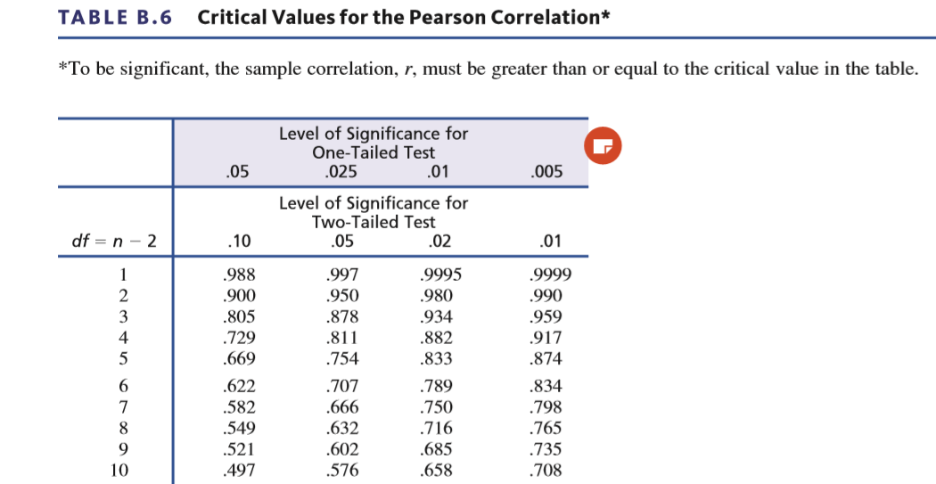
Using and Interpreting the Pearson Correlation (cont’d.)
The statistical significance of the Pearson correlation can be found by referring to a table of critical values.

Slide 14
Using and Interpreting the Pearson Correlation (cont’d.)
When you encounter correlations, there are four additional considerations that you should bear in mind.
Correlation simply describes a relationship between two variables.
It does not explain why the two variables are related. Specifically, a correlation should not and cannot be interpreted as proof of a cause-and-effect relationship between the two variables.

Slide 15
Using and Interpreting the Pearson Correlation (cont’d.)
The value of a correlation can be affected greatly by the range of scores represented in the data.
One or two extreme data points, often called outliers, can have a dramatic effect on the value of a correlation.

Slide 16
Using and Interpreting the Pearson Correlation (cont’d.)
When judging how “good” a relationship is, it is tempting to focus on the numerical value of the correlation. However, a correlation should not be interpreted as a proportion.
To describe how accurately one variable predicts the other, you must square the correlation. Thus, a correlation of r = .5 means that one variable partially predicts the other, but the predictable portion is only r² = .5² = 0.25 (or 25%) of the total variability.

Slide 17
Correlation and Causation
One of the most common errors in interpreting correlations is to assume that a correlation necessarily implies a cause-and-effect relationship between the two variables.
Although there may be a causal relationship, the existence of a correlation does not prove it.
To establish a cause-and-effect relationship, it is necessary to conduct a true experiment in which one variable is manipulated and other variables are rigorously controlled.

Slide 18
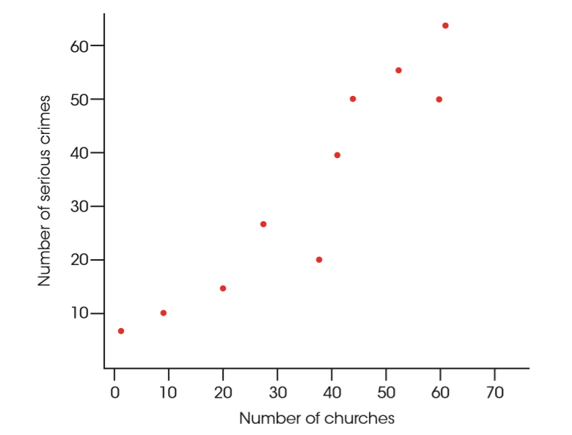
Hypothetical Data
Notes:
Figure 15.5 Hypothetical data showing the logical relationship between the number of churches and the number of serious crimes for a sample of U.S. cities.
Suppose we select a variety of different cities and towns throughout the United States and measure the number of churches (X variable) and the number of serious crimes (Y variable) for each. A scatter plot showing hypothetical data for this study is presented in Figure 15.5. Notice that this scatter plot shows a strong, positive correlation between churches and crime. You also should note that these are realistic data. It is reasonable that the small towns would have less crime and fewer churches and that the large cities would have large values for both variables. Does this relationship mean that churches cause crime? Does it mean that crime causes churches? It should be clear that both answers are no. Although a strong correlation exists between churches and crime, the real cause of the relationship is the size of the population.

Slide 19
Correlation and Restricted Range
Whenever a correlation is computed from scores that do not represent the full range of possible values, you should be cautious in interpreting the correlation.
To be safe, you should not generalize any correlation beyond the range of data represented in the sample.
For a correlation to provide an accurate description for the general population, there should be a wide range of X and Y values in the data.

Slide 20
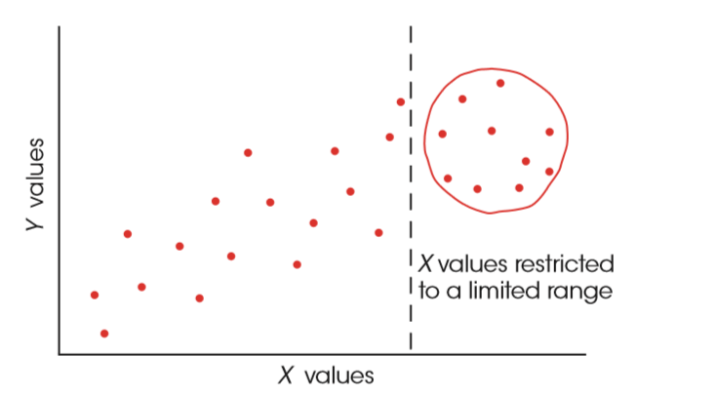
Restricted Ranges
Notes:
FIGURE 15.6 In this example, the full range of X and Y values shows a strong, positive correlation, but the restricted range of scores produces a correlation near zero.

Slide 21
Outliers
An outlier is an individual with X and/or Y values that are substantially different (larger or smaller) from the values obtained for the other individuals in the data set.
The data point of a single outlier can have a dramatic influence on the value obtained for the correlation.

Slide 22
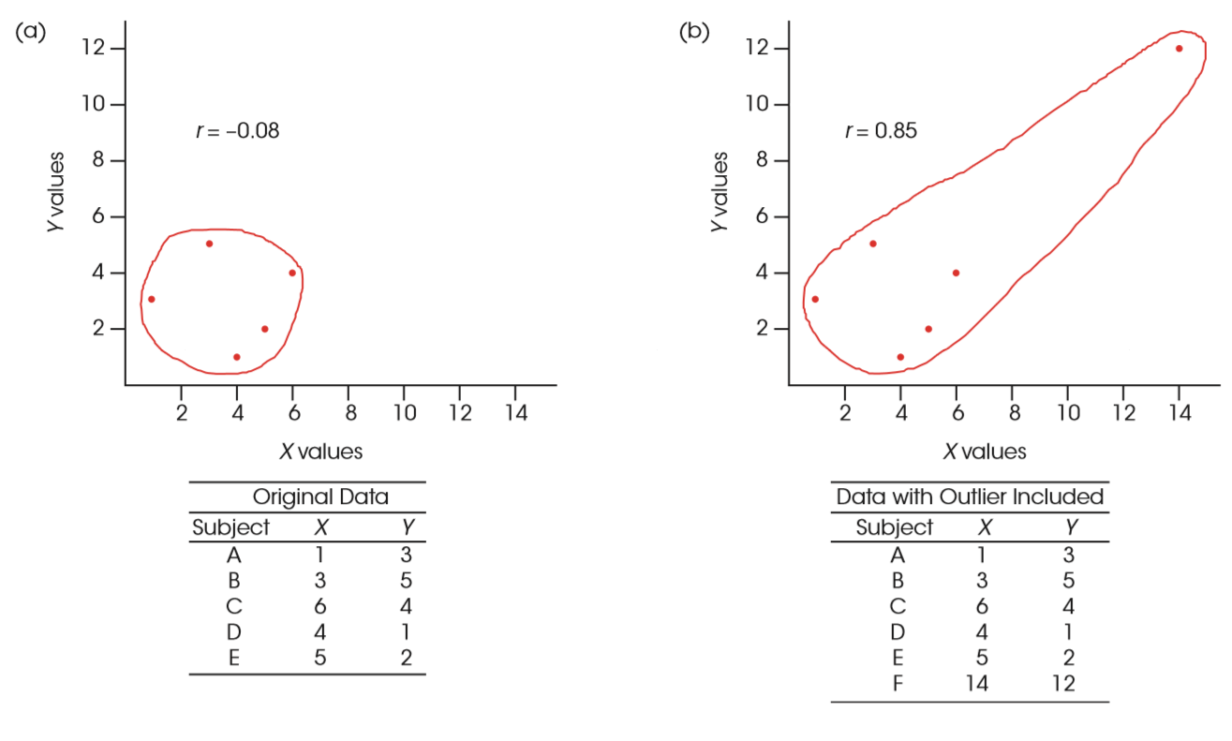
The Effect of an Outlier
Notes:
Figure 15.7 A demonstration of how one extreme data point (an outlier) can influence the value of a correlation.

Slide 23
Correlation and the Strength of the Relationship
A correlation measures the degree of relationship between two variables on a scale from 0–1.00.
Although this number provides a measure of the degree of relationship, many researchers prefer to square the correlation and use the resulting value to measure the strength of the relationship.

Slide 24
Correlation and the Strength of the Relationship (cont’d.)
The value r² is called the coefficient of determination because it measures the proportion of variability in one variable that can be determined from the relationship with the other variable.

Slide 25
Three Sets of Data
Notes:
FIGURE 15.8 Three sets of data showing three different degrees of linear relationship.

Slide 26
Correlation and the Strength of the Relationship (cont’d.)
When there is a less-than-perfect correlation between two variables, extreme scores (high or low) for one variable tend to be paired with the less extreme scores (more toward the mean) on the second variable.
This fact is called regression toward the mean.

Slide 27
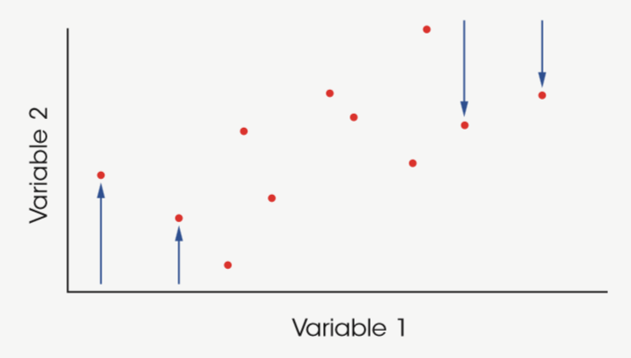
Regression Toward the Mean
Notes:
FIGURE 15.9 A demonstration of regression toward the mean. The figure shows a scatter plot for data with a less-than-perfect correlation. Notice that the highest scores on variable I (extreme right-hand points) are not the highest scores on variable 2, but are displaced downward toward the mean. Also, the lowest scores on variable 1 (extreme left-hand points) are not the lowest scores on variable 2, but are displaced upward toward the mean.

Slide 28
Partial Correlations
Occasionally a researcher may suspect that the relationship between two variables is being distorted by the influence of a third variable.
A partial correlation measures the relationship between two variables while controlling the influence of a third variable by holding it constant.

Slide 29
Partial Correlations (cont’d.)
In a situation with three variables, X, Y, and Z, it is possible to compute three individual Pearson correlations:
r_{XY} measuring the correlation between X and Y
r_{XZ} measuring the correlation between X and Z
r_{YZ} measuring the correlation between Y and Z

Slide 30
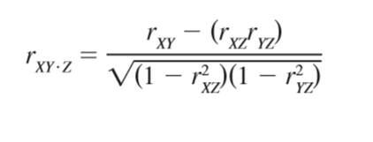
Partial Correlations (cont’d.)
These three individual correlations can then be used to compute a partial correlation.
For example, the partial correlation between X and Y, holding Z constant, is determined by the formula

Slide 31
Hypothetical Data
Notes:
TABLE 15.2 Hypothetical data showing the relationship between the number of churches, the number of crimes, and the populations for a set of n = 15 cities.

Slide 32
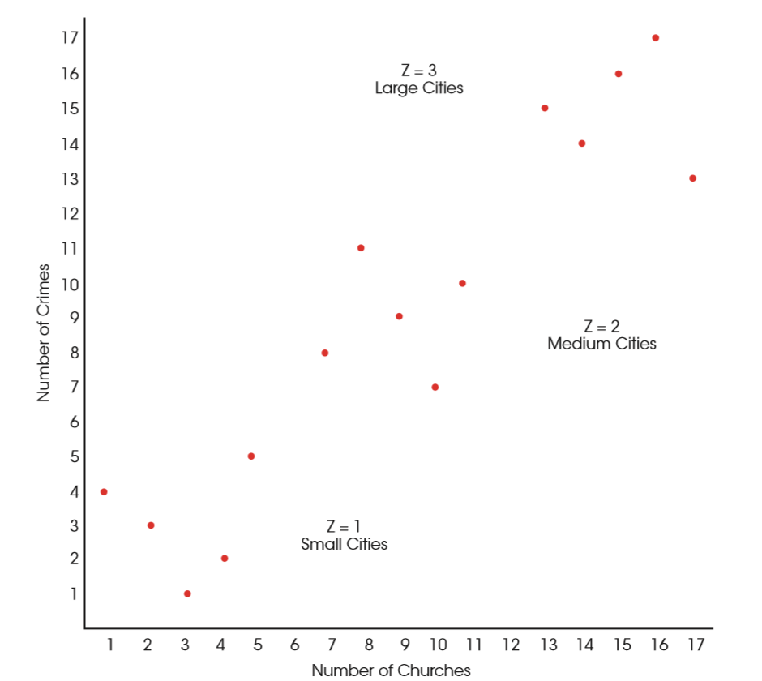
Hypothetical Data Showing the Logical Relationship
Notes:
FIGURE 15.10 Hypothetical data showing the logical relationship between the number of churches and the number of crimes for three groups of cities: those with small populations (Z = 1), those with medium populations (Z = 2), and those with large populations (Z = 3).

Slide 33
Hypothesis Tests with the Pearson Correlation
The basic question for this hypothesis test is whether a correlation exists in the population.
The null hypothesis is “No. There is no correlation in the population.” or “The population correlation is zero.”
The alternative hypothesis is “Yes. There is a real, nonzero correlation in the population.”

Slide 34
Hypothesis Tests with the Pearson Correlation (cont’d.)
Because the population correlation is traditionally represented by ρ (the Greek letter rho), these hypotheses would be stated in symbols as
H₀: ρ = 0
H₁: ρ ≠ 0

Slide 35
Hypothesis Tests with the Pearson Correlation (cont’d.)
When there is a specific prediction about the direction of the correlation, it is possible to do a directional, or one-tailed test.
For example, if a researcher is predicting a positive relationship, the hypotheses would be
H₀: ρ < 0
H₁: ρ > 0

Slide 36
Hypothesis Tests with the Pearson Correlation (cont’d.)
The hypothesis test evaluating the significance of a correlation can be conducted using either a t statistic or an F-ratio.
The t statistic for a correlation has the same general structure as other t statistics:
t = sample statistic - population parameter
standard error

Slide 37
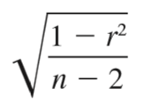
Hypothesis Tests with the Pearson Correlation (cont’d.)
In this case, the sample statistic is the sample correlation (r) and the corresponding parameter is the population correlation (ρ).
The null hypothesis specifies that the population correlation is ρ = 0.
The final part of the equation is the standard error, which is determined by

Slide 38
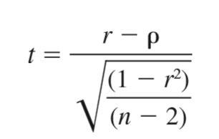
Hypothesis Tests with the Pearson Correlation (cont’d.)
The complete t statistic is
The t statistic has degrees of freedom defined by df = n – 2.

Slide 39
Spearman Correlation
The Spearman correlation is used in two general situations:
It measures the relationship between two ordinal variables; that is, X and Y both consist of ranks.
It measures the consistency of direction of the relationship between two variables.
The Pearson correlation measures the degree of linear relationship between two variables.
However, a researcher often expects the data to show a consistently one-directional relationship but not necessarily a linear relationship.

Slide 40
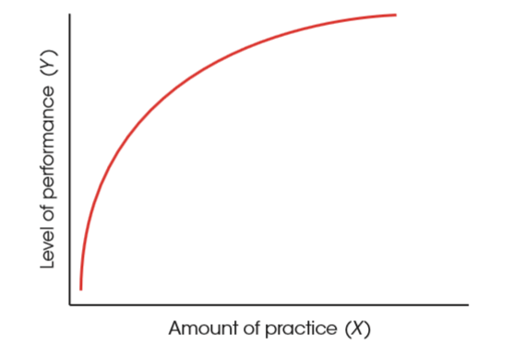
A Consistent Positive Relationship
Notes:
FIGURE 15.13 The relationship between practice and performance. Although this relationship is not linear, there is a consistent positive relationship: an increase in performance tends to accompany an increase in practice.

Slide 41
Spearman Correlation (cont’d.)
The calculation of the Spearman correlation requires:
Two variables are observed for each individual.
The observations for each variable are rank ordered. Note that the X values and the Y values are ranked separately.
After the variables have been ranked, the Spearman correlation is computed by either:
Using the Pearson formula with the ranked data.
Using the special Spearman formula (assuming there are few, if any, tied ranks).

Slide 42
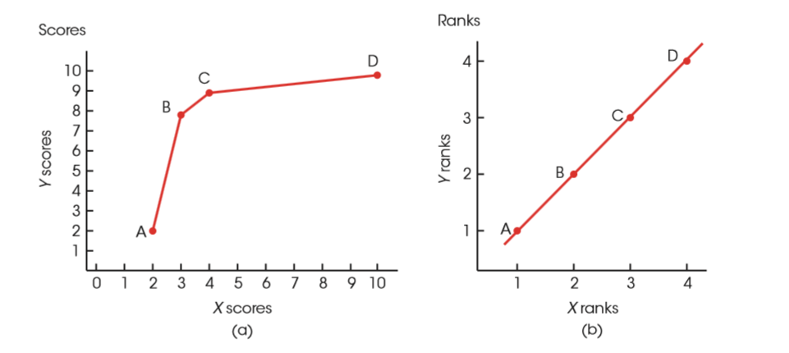
Scatter Plots
Notes:
FIGURE 15.14 Scatter plots showing (a) the scores and (b) the ranks for the data in Example 15.10. Notice that there is a consistent, positive relationship between the X and Y scores, although it is not a linear relationship. Also notice that the scatter plot for the ranks shows a perfect linear relationship.

Slide 43
Spearman Correlation (cont’d.)
When you are converting scores into ranks for the Spearman correlation, you may encounter two (or more) identical scores.
Whenever two scores have exactly the same value, their ranks should also be the same.
This is accomplished by the following procedure:
List the scores in order from smallest to largest. Include tied values in the list.
Assign a rank (first, second, etc.) to each position in the ordered list.

Slide 44
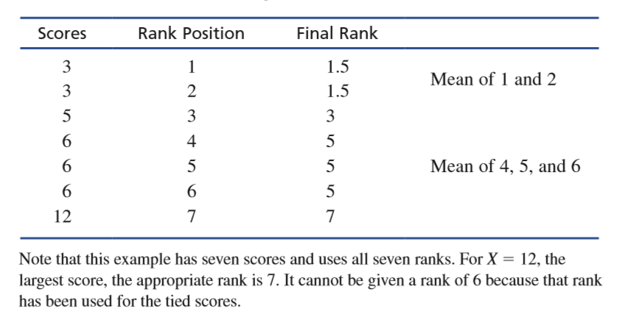
Spearman Correlation (cont’d.)
When two (or more) scores are tied, compute the mean of their ranked positions, and assign this mean value as the final rank for each score.

Slide 45
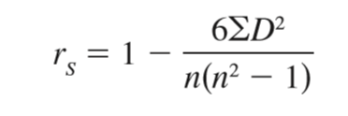
Spearman Correlation (cont’d.)
Because calculations with ranks can be simplified, these simplifications can be incorporated into the final calculations for the Spearman correlation.
Instead of using the Pearson formula after ranking the data, you can put the ranks directly into a simplified formula where D is the difference between the X rank and the Y rank for each individual:

Slide 46
Testing the Significance of the Spearman Correlation
Testing a hypothesis for the Spearman correlation is similar to the procedure used for the Pearson r.
The basic question is whether a correlation exists in the population.
The null hypothesis states that there is no correlation (no monotonic relationship) between the variables for the population, or in symbols:
H₀: ρ_{S} = 0

Slide 47
Testing the Significance of the Spearman Correlation (cont’d.)
The alternative hypothesis predicts that a nonzero correlation exists in the population, which can be stated in symbols as
H₁ ≠ ρ_{S} 0

Slide 48
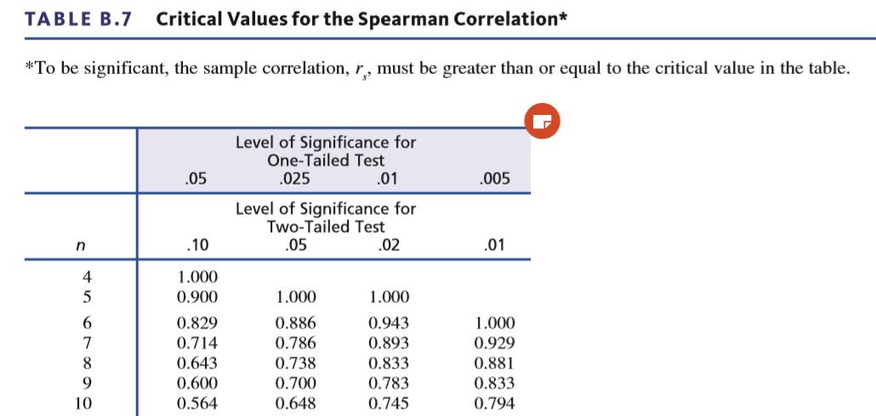
Testing the Significance of the Spearman Correlation (cont’d.)
To determine whether the Spearman correlation is statistically significant, use a table of critical values.

Slide 49
The Point-Biserial Correlation
The point-biserial correlation is used to measure the relationship between two variables in situations in which one variable consists of regular, numerical scores, but the second variable has only two values.
A variable with only two values is called a dichotomous variable or a binomial variable.

Slide 50
The Point-Biserial Correlation (cont’d.)
The calculation of the point-biserial correlation proceeds as follows:
Assign numerical values to the two categories of the dichotomous variable(s).
Traditionally, one category is assigned a value of 0 and the other is assigned a value of 1.
Use the regular Pearson correlation formula to calculate the correlation.

Slide 51
The Point-Biserial Correlation (cont’d.)
The point-biserial correlation is closely related to the independent-measures t test.
When the data consists of one dichotomous variable and one numerical variable, the dichotomous variable can also be used to separate the individuals into two groups.
Then, it is possible to compute a sample mean for the numerical scores in each group.

Slide 52
Alternatives to the Pearson Correlation
In this case, the independent-measures t test can be used to evaluate the mean difference between groups.
If the effect size for the mean difference is measured by computing r² (the percentage of variance explained), the value of r² will be equal to the value obtained by squaring the point-biserial correlation.

Slide 53
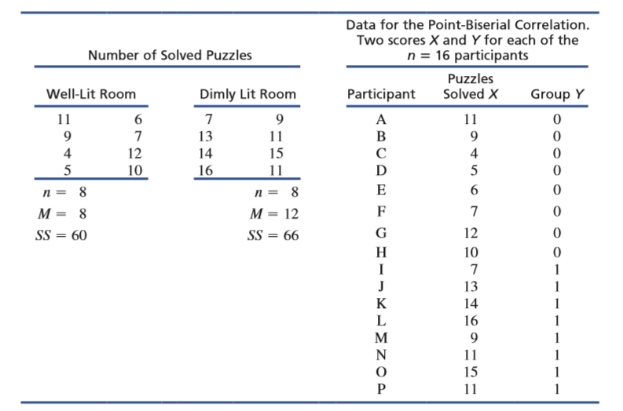
Data Formats
Notes:
TABLE 15.4 The same data are organized in two different formats. On the left-hand side, the data appear as two separate samples appropriate for an independent-measures t hypothesis test. On the right-hand side, the same data are shown as a single sample, with two scores for each individual: the number of puzzles solved and a dichotomous score (Y) that identifies the group in which the participant is located (Well-lit = 0 and Dimly lit = 1). The data on the right are appropriate for a point-biserial correlation.

Slide 54
The Phi-Coefficient
The phi-coefficient is used when both variables are dichotomous.
The calculation proceeds as follows:
Convert each of the dichotomous variables to numerical values by assigning a 0 to one category and a 1 to the other category for each of the variables.
Use the regular Pearson formula with the converted scores.

Slide 55
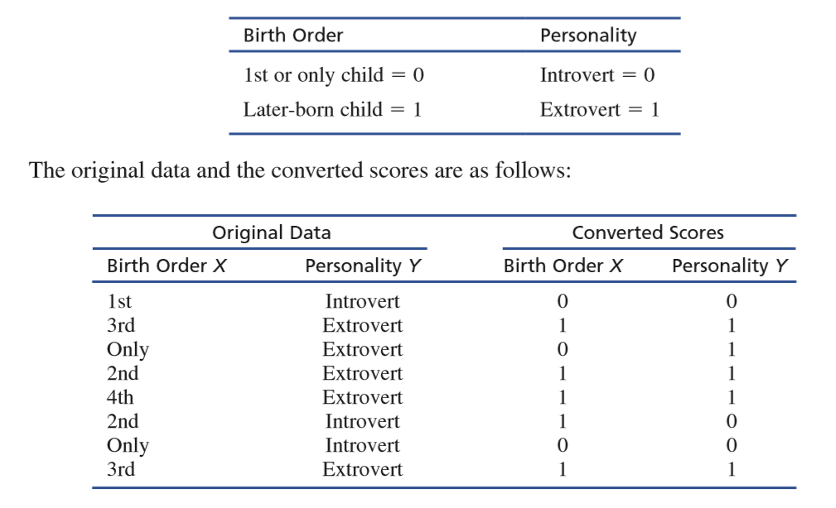
The Phi-Coefficient (cont’d.)

